Slide 1
IEO – week 9

Slide 2
This week
IP Routing
Maintenance and drawing of the infrastructure
Notes:
Applies to al electronic devices?

Slide 3
Layered Communication: TCP/IP Protocols Overview
Application Layer
HTTP
DNS
FTP
DHCP
DHCP
Telnet
SMTP
Transport Layer
TCP
UDP
Network Layer
IP
DataLink Layer
Ethernet
Wifi
Bluetooth
Physical Layer
Ethernet
Wifi
Bluetooth

Slide 4

IP Routing
IP Routing determines the path the data follows (through multiple networks) from the source to the destination IP address.

Slide 5
Socrative.com Quiz
Join the room SHAGHELANI

Slide 6
IP Routing
Static Routing
uses preconfigured routing tables
Dynamic Routing
uses routing protocols

Slide 7
IP Routing
Direct Route
Default Route
Host Route
Network Route

Slide 8
IP Routing
Direct Route
We talk about a direct route when a machine can send a packet to another machine without going through a third machine.

Slide 9
Direct Routing
Network LAN_A:
192.168.1.0/24
ifconfig eth0 192.168.1.1
ifconfig eth0 192.168.1.2
ifconfig eth0 192.168.1.254

Slide 10
Direct Routing
Network LAN_A:
192.168.1.0/24

Slide 11
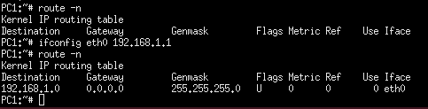
Direct Routing
Routing Table
Direct Route

Slide 12
IP Routing
Direct Route
Default Route
Host Route
Network Route

Slide 13
IP Routing
Default Route
A default route is route taking effect when no other route can be determined for a given Internet Protocol (IP) destination address.

Slide 14
Default routing
PC1 and PC2 want to communicate
with network LAN_B
PC3 and PC4 want to communicate
with network LAN_A
route add default gw 192.168.1.254
route add default gw 172.16.1.254
192.168.1.0/24
172.16.1.0/24

Slide 15
Default Routing
Network 192.168.1.0/24 is connected with network 172.16.1.0/24 through default router Router1.
Network 172.16.1.0/24 is connected with network 192.168.1.0/24 through default router Router1.
192.168.1.0/24
172.16.1.0/24

Slide 16

Default route
Routing Table
Direct Route
Indirect Route (G flag)
Default Route (Destination :0.0.0.0)

Slide 17
IP Routing
Direct Route
Default Route
Host Route
Network Route

Slide 18
IP Routing
Host Route
Host route is a route to a destination with a complete IP address.

Slide 19
Host Route
PC1 wants to communicate with PC4
route add 172.16.1.2 gw 192.168.1.254
PC1 has a Default Route to Router 2
Network 192.168.1.0/24
Network 172.16.1.0/24
Notes:
PC1 already uses default route by specifying Router2 as a default router to all external networks. If PC1 wants to communicate with PC4, it can’t use the default route, so it has to specify a different route, e.g. Host Route to PC4.

Slide 20
Host Route
Notes:
Note : The picture shows the new route with green color. To make a connection from PC1 to network PC4 and back, there should be also routing added from the PC4 to PC1. For the case of simplicity, the commands to add this routing were omitted.

Slide 21
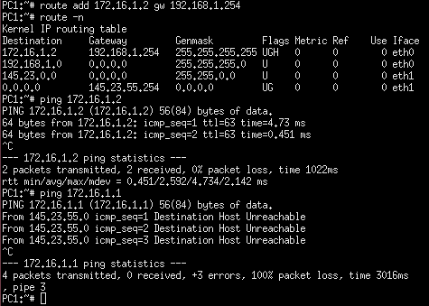
Host Route
Routing Table
Host Route
(flag H)

Slide 22
IP Routing
Direct Route
Default Route
Host Route
Network Route

Slide 23
IP Routing
Network Route
Network route is a route to a destination with a network address.

Slide 24
Network Route
PC1 wants to communicate with network LAN_B
route add –net 172.16.1.0 gw 192.168.1.254 netmask 255.255.255.0
PC1 has a Default Route to Router 2
Network 192.168.1.0/24
Network 172.16.1.0/24

Slide 25
Network Route
Notes:
Note : The picture shows the new route with green color. To make a connection from PC1 to network LAN_B and back, there should be also routing added from the network LAN_B to PC1. For the case of simplicity, the commands to add this routing were omitted.

Slide 26
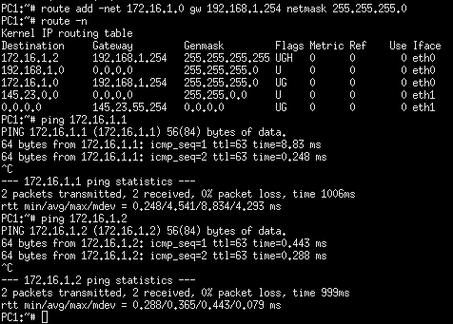
Network Route
Route Table
Host Route
Network Route

Slide 27

Several useful Linux networking commands
Check the routing tables:
route command
Example:
route -n
Show all routing entries of this node

Slide 28
Several useful Linux networking commands
Sniff the traffic on a network interface:
tcpdump command
Example:
tcpdump –i eth0
Sniff the traffic on the eth0 interface

Slide 29
Several useful Linux networking commands
Check the routing tables:
ip route show command
Example:
ip route show
Show all routing entries of this node

Slide 30

Questions?

